Slide 1
Overcome ML Challenges in Enterprise
Lessons learned from hundreds of ML projects
Feb 25, 2022
Prashant K Dhingra

Slide 2
Lesson Learned: Agenda
Experimentation in complex environment
Managing Model Development Life Cycle
Data for ML
Feature Engineering
Modeling
Operationalization
Others
Combine Psychology and other fields
Simplify requirements
QA

Slide 3
Lesson Learned: Bottoms up approach
We believed that solving complex problems require
forming a complete understanding of the problem
specifying its solution.
The advent of machine learning (ML) has shown we can solve problems by learning from data, even without at first fully understanding the problem or the solution.

Slide 4
Lesson Learned: Product development changed
Business model of software product does not work
Write code once and sell thousand time does not work.
Heart of ML Model is customer data
Fitting code to data, human in loop for feedback require constant support.
Plurality of method require for modeling is very high.

Slide 5
Example use cases

Slide 6
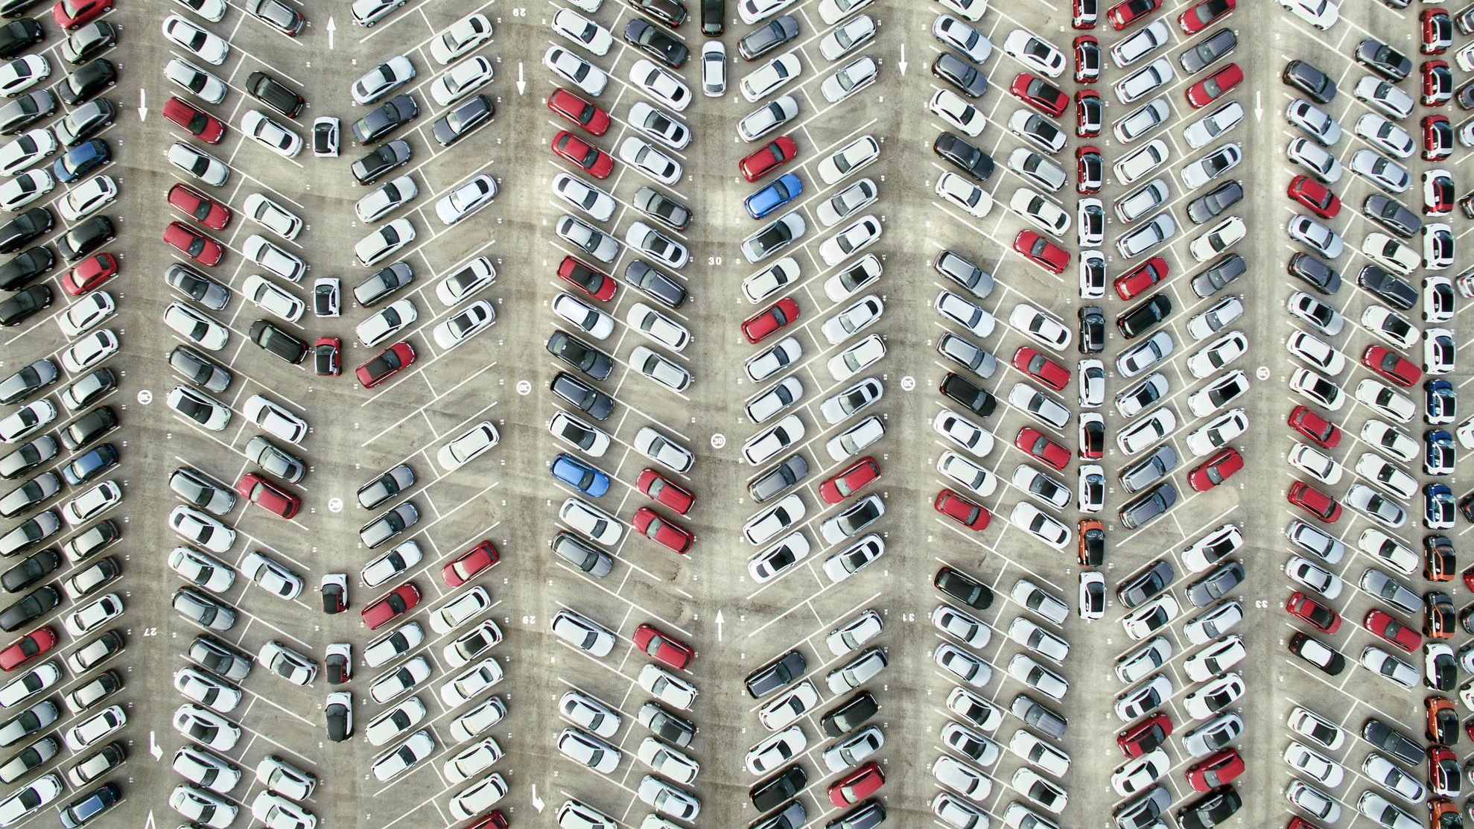

Imagine if you could…
[ predict which vehicle will fail ]
Notes:
As a starting point we need to clarify what we mean by IoT. The term is overloaded, but let’s stop and think.
Imagine a city with no congestion. Can IoT do that?

Slide 7
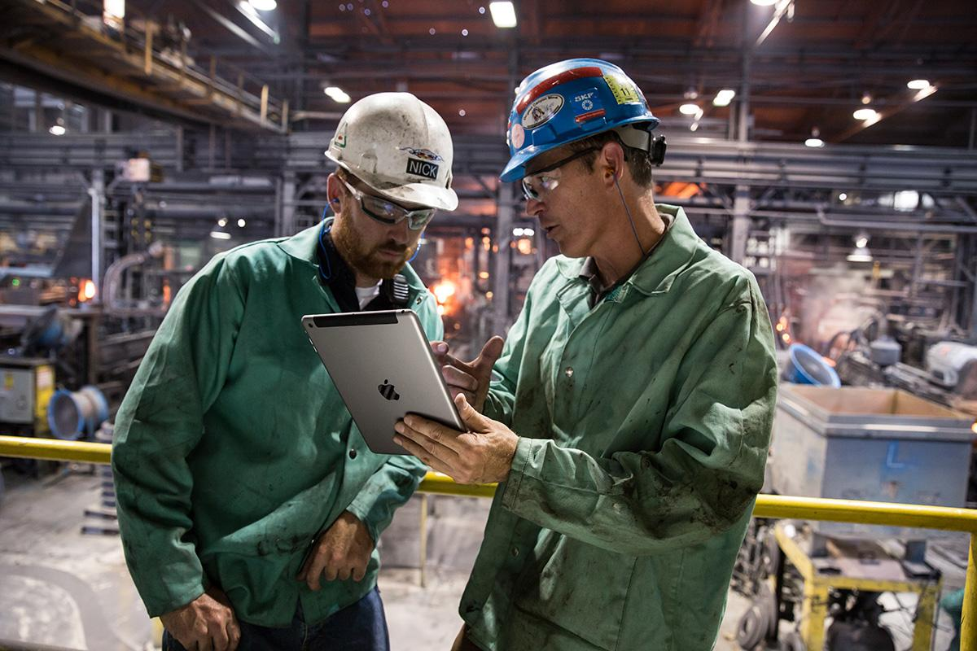
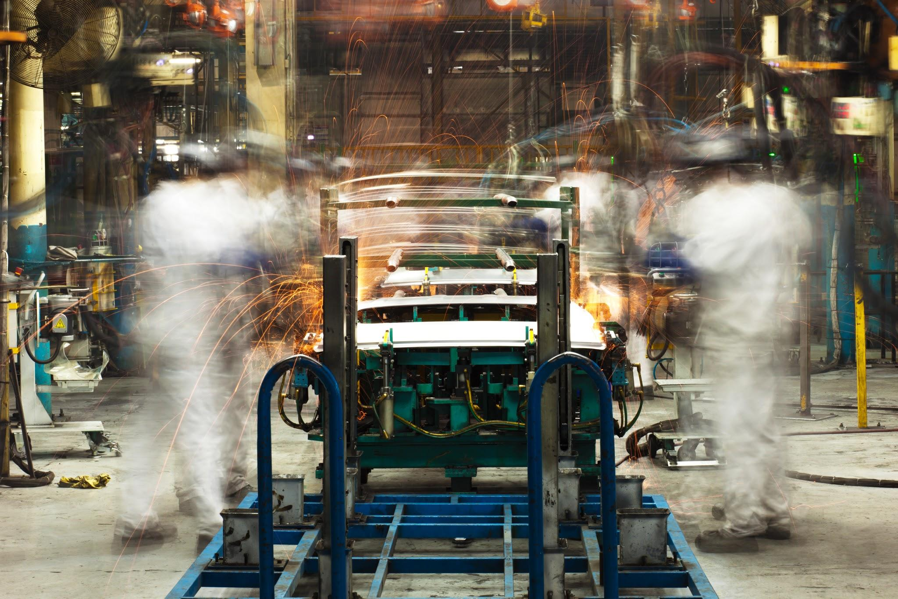
Imagine if you could…
[ predict the remaining life of machines ]
Notes:
Imagine no machine failure and no delays in production failure. Can IoT play a role here too?

Slide 8

Imagine if you could …
[ optimize energy consumption ]

Slide 9
AI Business case
Who is customer? Who is user?
What is the business problem?
Why use Machine Learning?
Does ML improve existing use case or is it a new use case ?
Do we need to check feasibility or turbo boost the ML model?
What are data sources? Do you have right data sets?
What are ethical/legal/compliance challenges ?
Will the solution generate revenue, save cost, improve safety etc ?
What is the pricing model ? Who will sell solution and how?
How will you maintain the solution ?

Slide 10
Business use case
ML use case
Describe how ML improve existing use case
Focus on what to predict and signals
Describe Signals, Data sources, Dataset
Specify how to measure results
Business problem
User, Customer, Actor
Flow of events
Flow of alternate events
Functionality and result
Benefit
Process change

Slide 11
Form the hypothesis Convert use case into ML use case
Predict if equipment will fail in next ‘N’ period
Predict if equipment will fail in next ‘N1’, ‘N2’.. period.
Predict if equipment will fail in next ‘N’ period due to fault in part ‘X’
Predict time to failure or remaining life of equipment
Find Anomalies
Others/Predict degradation

Slide 12
Metrics
Independence Metric design and Model design should be independent
Reliable: Same model should produce similar number on similar data
Easy: Easy to build and use in MVM (Minimum viable model)
One metric: If there are multiple metrics - select one metric to optimize and remaining should have minimum satisfaction criteria

Slide 13





ML Target State
Research & feasibility: research project to provide feasibility
Reliable models : Feasibility is proven. Need more effort to build reliable models.
Models to get insight/confidence: Model built and in use with manual intervention – offline.
Model in production: Models in production with automated system.
Mission critical models: Strong automation – training, inference, monitoring,

Slide 14
Lesson Learned:
ML Maturity

Slide 15
Lesson Learned: Experimentation

Slide 16
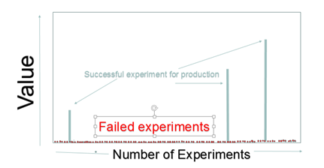
Orthogonal Dials for experimentation
Problem
Solutions
Prod
Usage in production
Pre prod
Domain Expert
Back testing/offline experiment
Test Hypothesis for markets, products, time period
Add Orthogonal dials to scale experimentation
ML Engineers
Code Modeling architectures

Slide 17
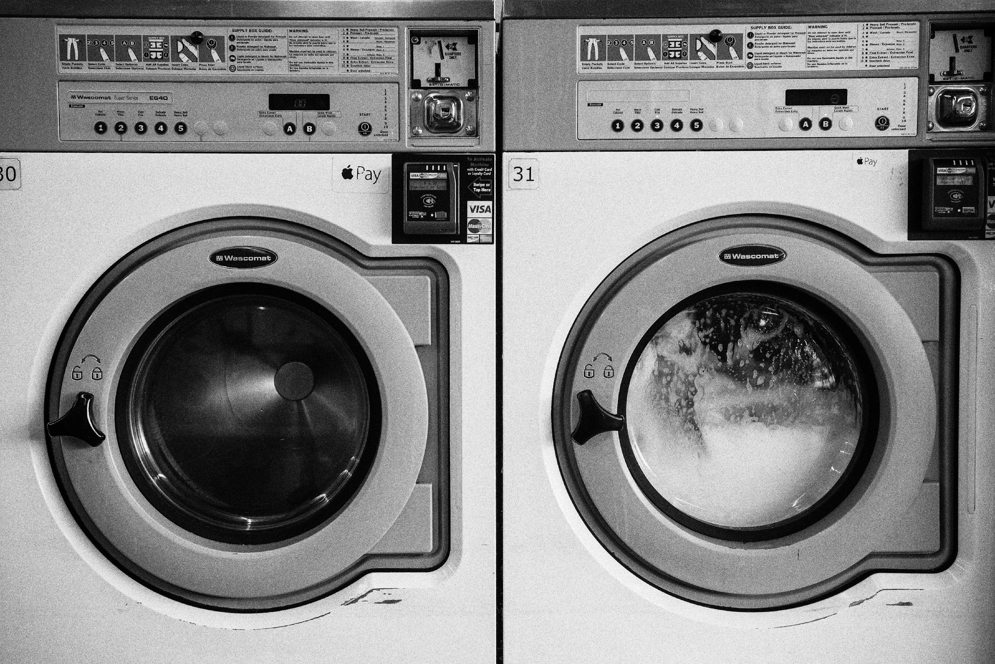

Orthogonal Dials: Experiment quicker and cheaper
Disclaimer - Any third party trademarks are the intellectual property of their respective owners and any mention herein is for referential purposes only.
Notes:
Source:www.unsplash.com

Slide 18
Lesson Learned: Methodology

Slide 19


Story of two teams
Notes:
Image source:www.unsplash.com

Slide 20
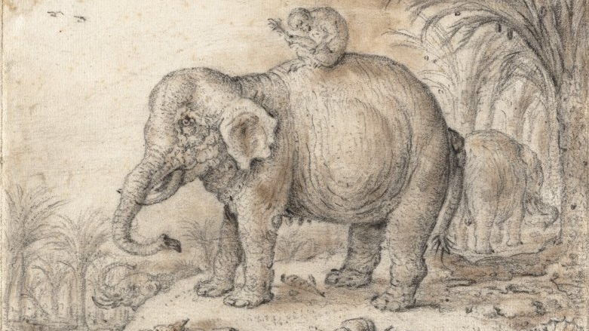
Approach
Notes:
Source: https://commons.wikimedia.org/wiki/File:Elephant_and_Monkey_by_Jan_Savery,_black_chalk_and_brownish_wash.jpg

Slide 21
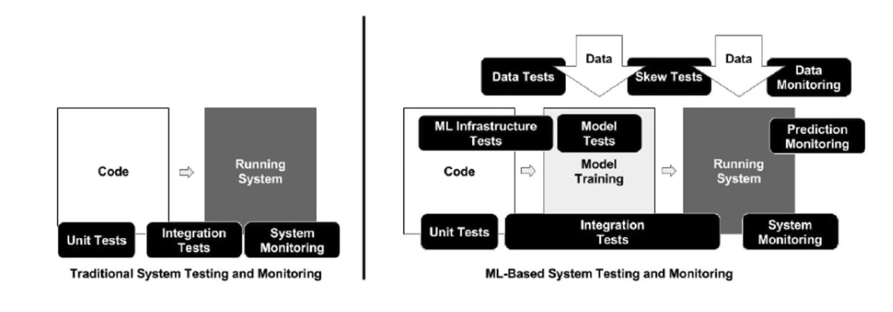
Application Development vs ML Development life cycle
Behavior of ML solution is learned from data. Process of managing data is different from managing code.
Source : What is your ML test score
Notes:
Source: https://static.googleusercontent.com/media/research.google.com/en//pubs/archive/aad9f93b86b7addfea4c419b9100c6cdd26cacea.pdf

Slide 22
ML Diagnostic System
Model reliability
Data drift, concept drift
Diagnostic
Data Quality
Freshness, Completeness
Distribution
Software and Infra
Reliability
Logs
Traces

Slide 23
Augment Agile
ML System consist of
Infrastructure
Workflow and Tools
ML Models
Method
SDLC
MDLC
Data sprint
Experimentation sprint
Feature sprint

Slide 24
Lesson Learned: ML Leadership
Rather than just involving oversight and planning, managing a data science research effort tends to be a dynamic and self-correcting process; it is difficult to plan precisely either a project's timing or final outcomes.
https://sloanreview.mit.edu/article/why-managing-data-scientists-is-different/
ML Leaders need to reduce research iteration by using appropriate ML strategy
More Data, Different Data
Better Sampling. Better Labels
More Compute. Better algorithm
Others
Know metrics and evaluation method well.
Have experience in building ML solutions and data driven components
Understand operationalization
Notes:
Source: https://sloanreview.mit.edu/article/why-managing-data-scientists-is-different/

Slide 25

Lesson Learned: Data
Software Development vs Model Development
Do not treat data object as code object
Avoid data copies. Do ML where data is.
Trade off – modularity vs accuracy
Data analysis
Extend Business Intelligence (BI) for modeling
Modeling
Data engineering
Notes:
Data Scientist build model on Sandbox by combining data from multiple sources. Taking these model
to production is complex task. Proposal : Do ML where data is. Avoid making copies of data.

Slide 26
Lesson Learned:
Learn more with less data

Slide 27
Learn more with less data
1
2
3
4
Identify use case –
Define ML hypothesis
Train Model
Predict new data
(Operationalize)
Capture examples –
Select data source
Supervised learning need labeled Data. Labels are expensive and time consuming to get.
Data points have different importance. Importance depends on tasks (business need)
For Big Data and Deep Learning labeling need are enormous.
There are not enough humans on planet to label Video, Speech data

Slide 28
Active Learning
Why: Enterprises have plenty of data. A key barrier to entry is labeled data
What : Label those example that contribute most to model quality
How : Use Active Learning. Start with standard small labeled set.
Determine which unlabeled example is most important e.g. most uncertain, most likely to increase model accuracy, controversial, valuable to business.
Outcome is “Gold Training Set”
Active learning is a special case of semi-supervised machine learning in which a learning algorithm is able to interactively query to obtain the desired outputs at new data points.
Gold Training Set
Note: Label Augmentation, Label Generation, Programmatic interface are additional tactics

Slide 29
Lesson Learned: Features

Slide 30
Lesson Learned: Feature
Use SDLC process to compute features including unit test, integration test etc.
Determine feature importance vs cost of adding features. How much effort needed to bring feature for training, inference? Impact on compute , memory etc.
Ensure that security and privacy control are applied appropriately on transformed features.
Develop test to measure distribution of features in training and in production.
Define features meta data based on underlying data e.g. moving avg. of sensor is between 50 and 80. Ensure unit and integrated tests are in place to check values.
Instead of building features as part of each model, build features at common place (see next slide).

Slide 31
Feature Engineering
Train Model
Identify use case –
Define ML hypothesis
Capture examples –
Select data source
Predict new data
(Operationalize)
A
B
C
D
E
Metric selection
Data exploration
Feature Engineering
Algorithm Selection
Model training
Each data scientist build own feature. Spend 50-70% of time.
Feature with similar name and meaning are built in inconsistent manner leading to errors, poor feature management.

Slide 32
Feature Mart
Why : Each model has its on features.
How : Build features at center place and enable reuse.
What : Enterprise feature store contains highly curated data & features to power ML.
Benefits :
Cost of building additional model goes down.
Features become reproducible artifact that can be consumed by multiple models.
Features at single place allow comparison, correlation, backfilling etc.
Notes:
Unsplash.com

Slide 33

Lesson Learned: Model architecture

Slide 34
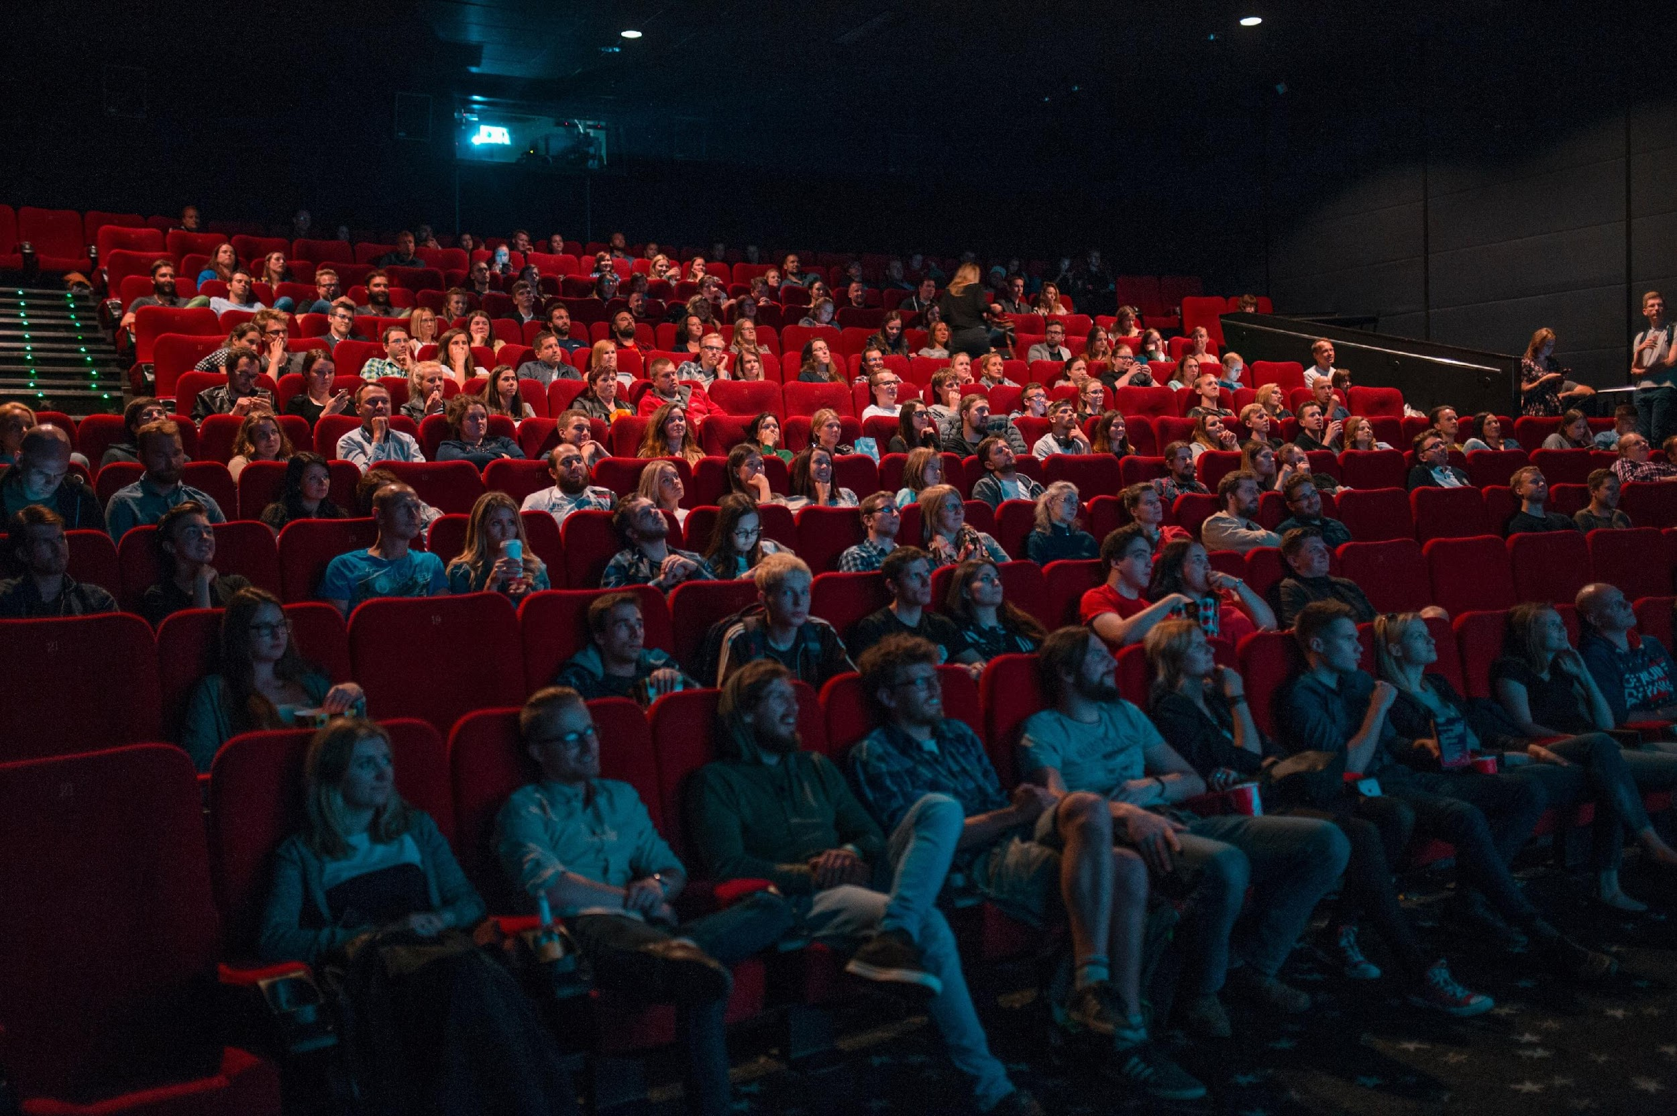

Model reuse consideration

Slide 35
Common Modeling Architectures
Classification
Multiclass classification
Regression
Anomaly detection
Traditional ML algorithms e.g.
Decision Trees, SVM
RandomForest, Decision Trees, Markov Chain
RF regression
Aanomaly detection
Plurality of method in ML is very high
DNN Classification
DNN Classification
DNN Regression
Autoencoder
RNN, LSTM
RNN, LSTM
RNN, LSTM
Conditional AutoEncoder
DNN – Deep Neural Network
RNN – Recurrent Neural Network
LSTM – Long Short Term Memory
Notes:
Source: : Prashant Google Blog
https://cloud.google.com/blog/products/data-analytics/a-process-for-implementing-industrial-predictive-maintenance-part-ii

Slide 36
Lesson Learned: Modeling
ML learns patterns in data. MDLC is different from SDLC. However teams need to follow code review, coding standard and version control guideline once experiment mature.
Modeling team should determine how frequently model need to be trained. Impact of using stale model should be determined. In many cases using stale model has negative impact.
Modeling team should determine model accuracy and quality (metric) on various data points e.g. month, quarters, years, markets, products.
Model should be tested for fairness and bias.

Slide 37
Lesson Learned: Operationalization

Slide 38
McKinsey Survey : Lessons Learned Operationalization
Out of 160 reviewed AI use cases:
But successful early AI adopters report:
88% did not progress beyond the experimental stage
Profit margins
3–15%
higher than industry average
Source: “Artificial Intelligence: The Next Digital Frontier?”, McKinsey Global Institute, June 2017

Slide 39
Business challenges in operationalization
ML in production
Act on production data. Transaction + Decision happen in a closed loop.
Impact business outcome instantly. It is more powerful than BI. In BI humans consume outcome and determine how to use it.
Example –
recommend product to user has direct impact on sales.
Transaction is fraud or not has direct impact on security, usability
Notes:
Design measurement diagnostic tool to detect model issues

Slide 40
Technical Challenges
Data collection
Process
Serving
Configuration
Data Verification
Data exploration
Feature extraction
ML Code
Governance
Analysis Tools
Monitoring
A small fraction of AI application system is composed of ML code. Surrounding infra is complex.
Different process is needed to manage - ML Code, Data, Trained model
Source : Hidden Technical Debt in ML
Notes:
Source: https://papers.nips.cc/paper/5656-hidden-technical-debt-in-machine-learning-systems.pdf

Slide 41
Technical challenges in operationalization
Pipeline for feature engineering does not match at time of training and inference
Multiple loosely coupled pipelines exist to get data from different sources. Many run in parallel
Pipelines have dependencies. Many dependencies include human intervention.
Jungle of SQL joins
Frameworks: Different framework and languages used e.g. Spark, Sci-kit learn, TensorFlow built using Python, R, Java.
Process : Multiple types of object involved – Code, Algorithm, Data, Trained Model, Metric. Each object type needs different process. Code can be handled thru SDLC and source control process.
Multiple instances: A/B test and ensemble model multiply the complexity
Culture: Data science (research) and production ops have different culture and expertise.

Slide 42





Lesson Learned: operationalization
Pipeline Integration testing: Apply standard integration testing on end to end pipeline.
Reproducible ML training : For debugging and auditability ML training should be reproducible.
Model validation: Validate model quality after each retraining offline before using in production
Model Rollback: Design and implement model rollback procedures.
Debugging and Diagnosis: Design and implement tools and process to debug, explain and diagnosis individual inference.

Slide 43
Lesson Learned: operationalization monitoring
Skewness: Design and implement methods to check skewness of data training vs inference.
Staleness : Monitor for model staleness. Alert if model quality is deteriorated.
Model validation: Validate model quality after each retraining offline before using in production

Slide 44
Lesson Learned: Explain ability in production

Slide 45

Model – Trust, Interpretability and Explain ability

Slide 46
Explainability
Explainability for different personas
Global explaination
Local explaination
Impact of explain ability in development vs production
Lesson Learned

Slide 47
Explainability methods
Sensitivity analysis
Individual conditional expectation (ICE)
Partial dependence plot (PDP)
Conditional partial dependence plot ( Conditional PDP)
Accumulated local effects (ALE)
Feature attribution/Importance
Ablation
Local interpretable model-agnostic explanations (LIME)
SHAP
Neural Network
Integrated Gradients

Slide 48

AI-Human interaction
Cooperative conversation

Slide 49

Co-operative conversation/interaction
When we speak listener expect us to say truth, be relevant and clear.
English Philosopher Paul Grice defined this as principle of co-operative conversation.
Principle of co-operative conversation has 4 maxims
Quality
Quantity
Relevance
Manner
These are universal principles. It is applicable to all languages and culture.
Deliberate and apparent violation of maxims is called flouting. Unnecessary inference obtained from
Flouting of maxims are called implicatures.
Notes:
Example conversation –
How much is credit card fee?
almost free (vague, quality is issue)
less than capital bank (quantity)
you get points that will pay (relevance)
enjoy the freedom of spending, do not worry about annual fee (manner)
How is new developer
he is nice (irrelevant)

Slide 50
Emotional analysis using ML
Combine ML and Psychology

Slide 51
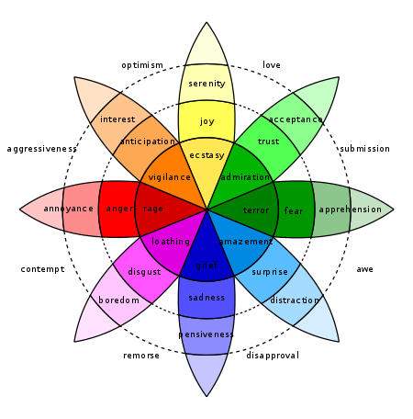
Wheel of emotions
Notes:
Photo credit : https://en.wikipedia.org/wiki/Robert_Plutchik
Psychologist Robert Plutchik defined 8 basic emotions.

Slide 52
Derive emotions from sentiment analysis
I am glad to do test drive on Tesla Model 3. The drive in city was smooth. I have pleasant experience in driving on highway too. The thing that worried me most is where to charge when I travel long distance. I believe Tesla has various charging stations on highway. Other factor I have concern is car cost. My monthly EMI will be bigger than cost saving from fuel. I am hopeful that with time electric car cost will come down and I will be able to enjoy wonderful car at good price.
Trust
Anticipation
Happiness
Fear
disgust
sad
Surprise
Anger
Emotion Insight
“Customer love product, ok with charging but not price”
Trust and Happiness 🡪Love
Trust and fear 🡪Submission

Slide 53
Lesson Learned: Redefine requirements for simpler solutions
Water flow in rivers

Slide 54
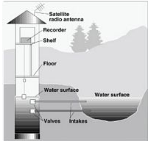
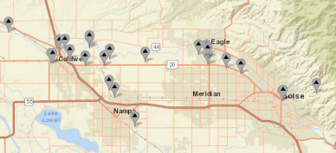
Emergency response team
Water flow in river
Govt has $20B to install stream gages. Each gage cost 50K. There is 200 million dollar of operational cost to maintain this.
Gage breaks time to time. They break more often during flood, strom etc. Many times floating tree in river can break gage
During flood, storm event emergency response team need gage data to determine which areas are at flood risk.
Looked into data and reached to conclusion that “predictive maintenance for gages” is not an appropriate scenarion
Looked into data and determine forecasting waterflow in river is extremly hard as water patterns depends on weather, snow on mountain, amount of snow melt due to temperature, reservioir and dam setting.
Notes:
Photo credit – usgs.gov
Research paper I wrote - https://onlinelibrary.wiley.com/doi/pdf/10.1111/1752-1688.12555

Slide 55
Stream Flow Estimate using ML
Stream Flow using Gage
Stream gage collects data about water flow.
1
1
Using ML, create cluster of stream gages. Clustering is done on time series data.
2
Gage breaks time to time. They break more often during flood, storm etc.
2
Identify degree of correlation between a stream gage and remaining gages within cluster.
3
Many times floating tree in river can break gage
When a stream gage “A” breaks use above and make prediction on “A” waterflow.
3
4
Data is at risk when needed most
4
Govt agencies get >90% accurate information of waterflow. Govt save money on repair, operational cost.
Gages break more often in Alaska in winter, Flood prone areas. It is extremly risky to replace gages during such period
5
Save lives
5
Notes:
Research paper I wrote - https://onlinelibrary.wiley.com/doi/pdf/10.1111/1752-1688.12555

Slide 56
Summary
Enterprise need to execute hundreds of experiments
Semi Automate execution of experiment with Orthogonal dials
Use ML to build data set. Consider approaches eg. Active Learning, Transfer Learning, Snorkeling, Meta learning
Build features at common place for reuse
Select modeling architecture according to shape and sparsity of data
Determine level of maturity needed in ML projects and accordingly implement.

Slide 57
Q&A

Slide 58
Lesson Learned: Effort and Skill set
Analogy
Flu shot vs Physiotherapy
Car driving vs aircraft

Slide 59
Lesson Learned: Data

